Slide 1
Foundation of computer science
By : Mohaemd Agami

Slide 2
Lecture 5
Motherboard part 2

Slide 3
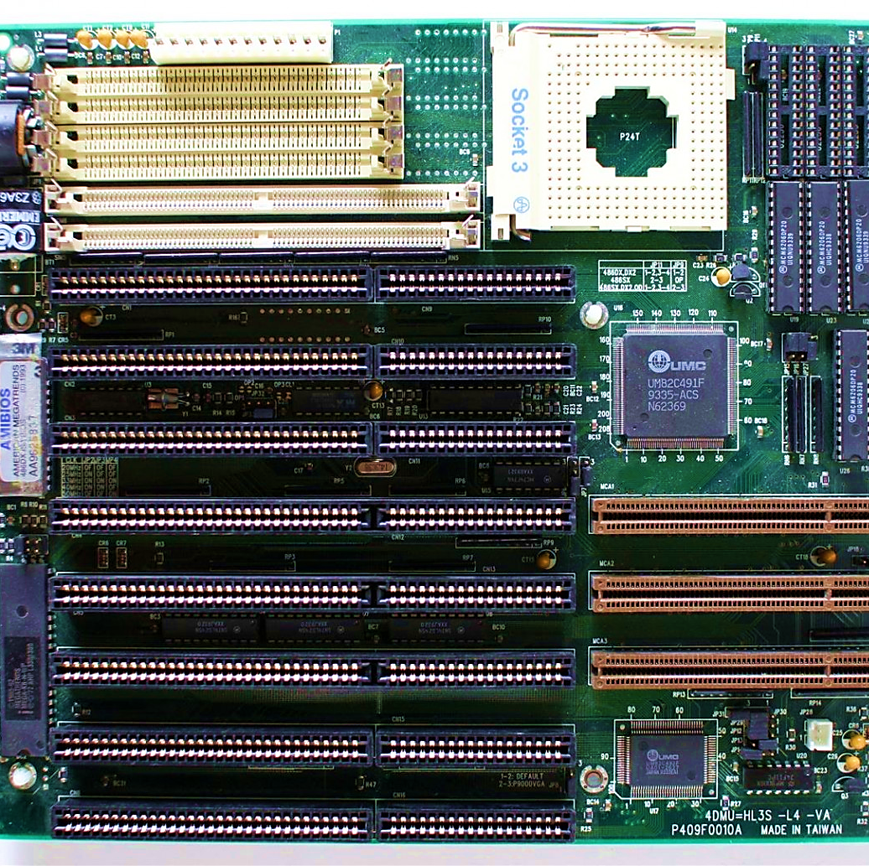
Buses and slots

Slide 4
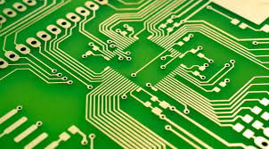
Traces
Traces on the motherboard transfer data and power between different components.
Bus
The bus in a motherboard transfers data between components and devices.

Slide 5
Binary system
128 bits
11001100110011001100110011001100110011001100110011001100110011001100110011001100110011001100110011001100110011001100110011001100
64 bits
1100110011001100110011001100110011001100110011001100110011001100
32 bits
10101011001100101010110011001100
16 bits
1100101010111001
8 bits
10001111

Slide 6
Example about 8 bit
0
CPU
RAM
0
1
1
1
0
1

Slide 7
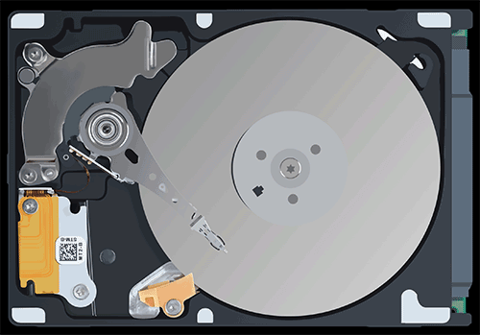
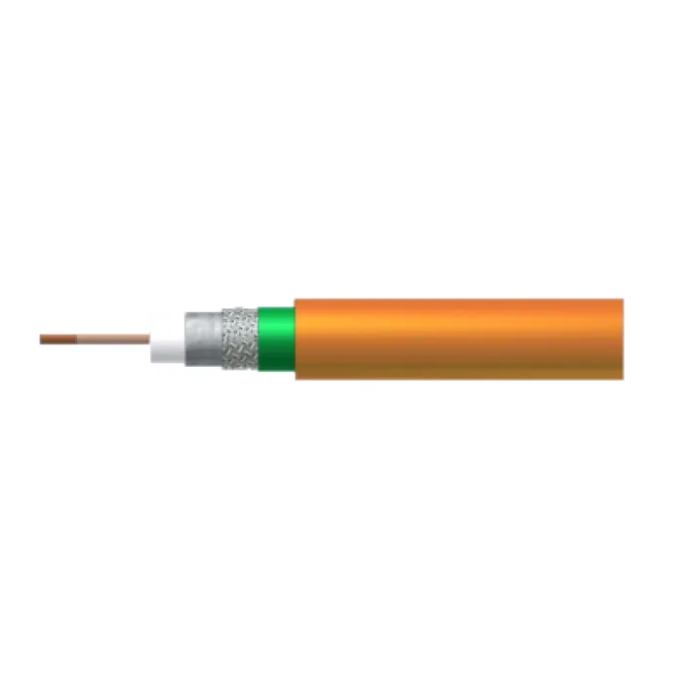
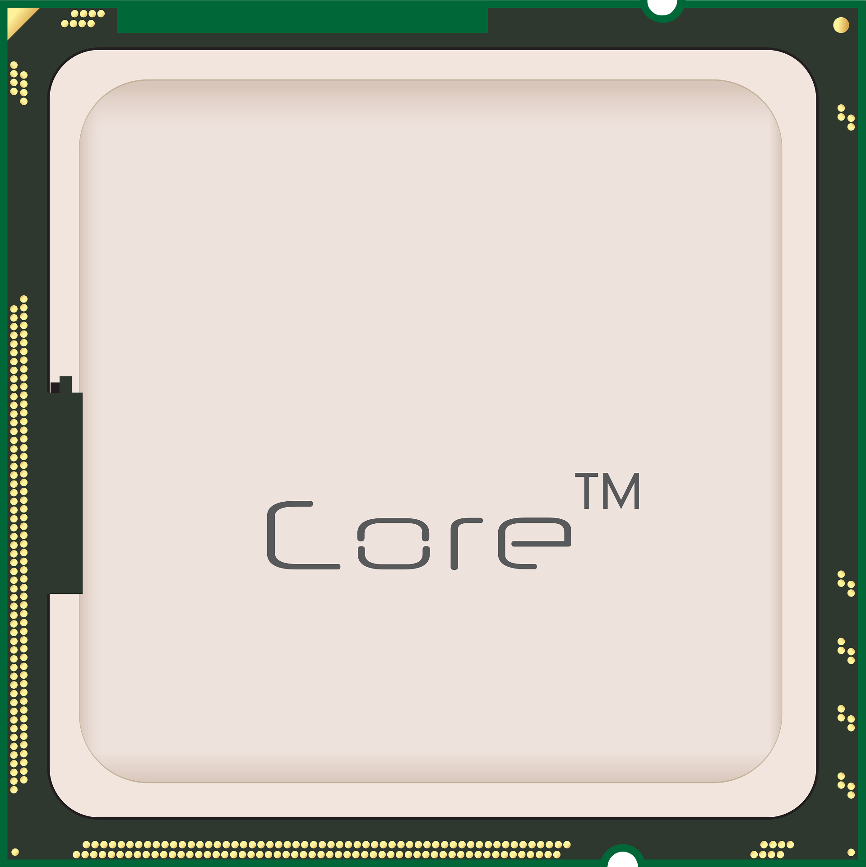
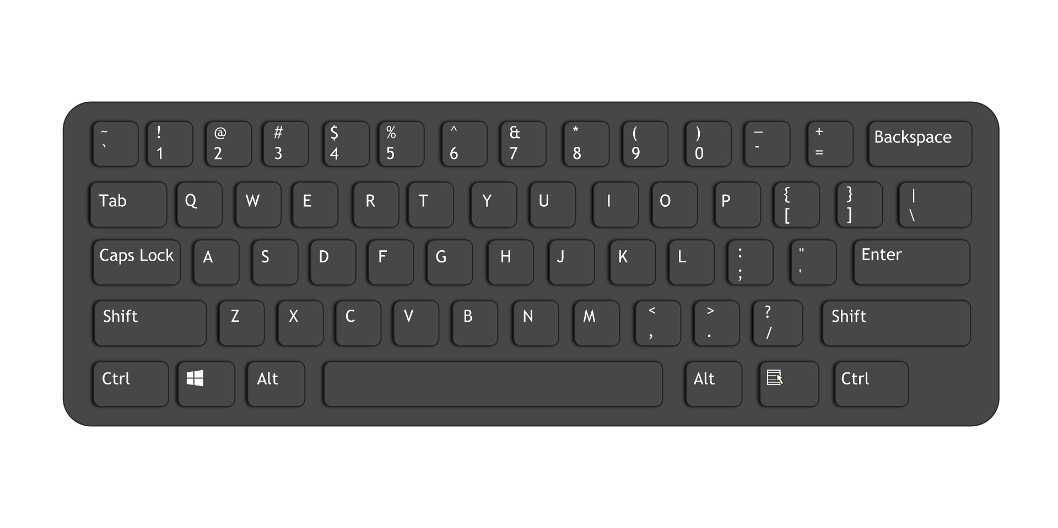
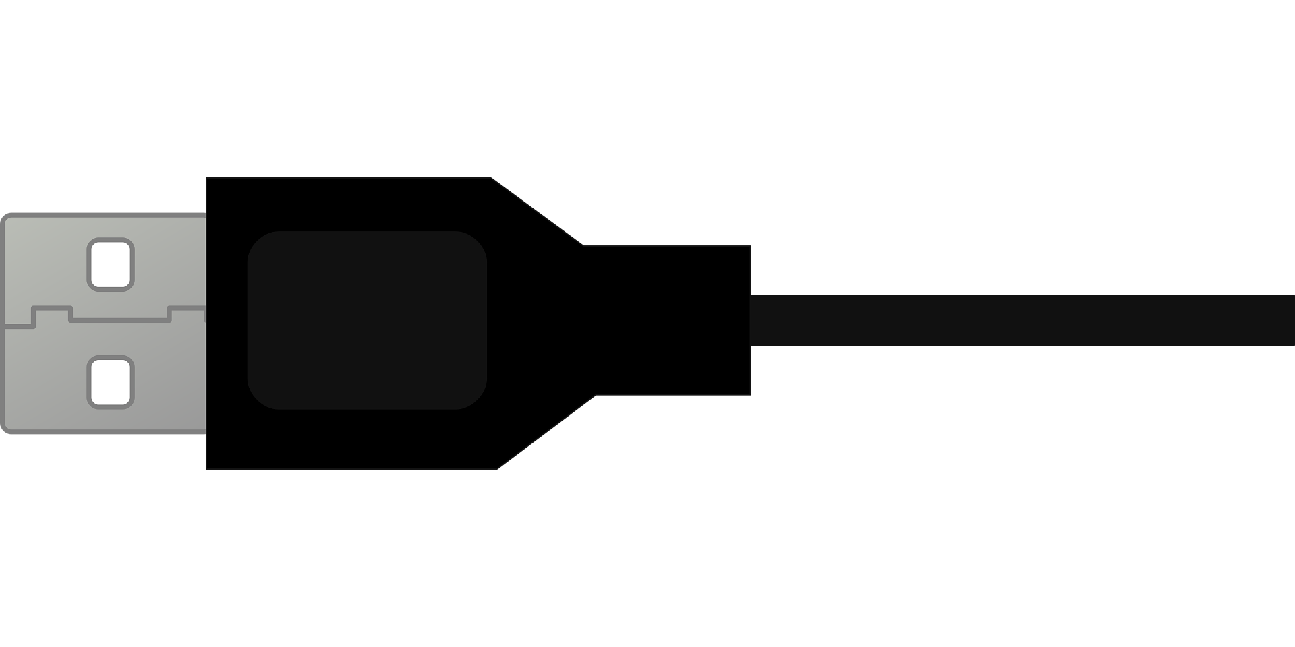
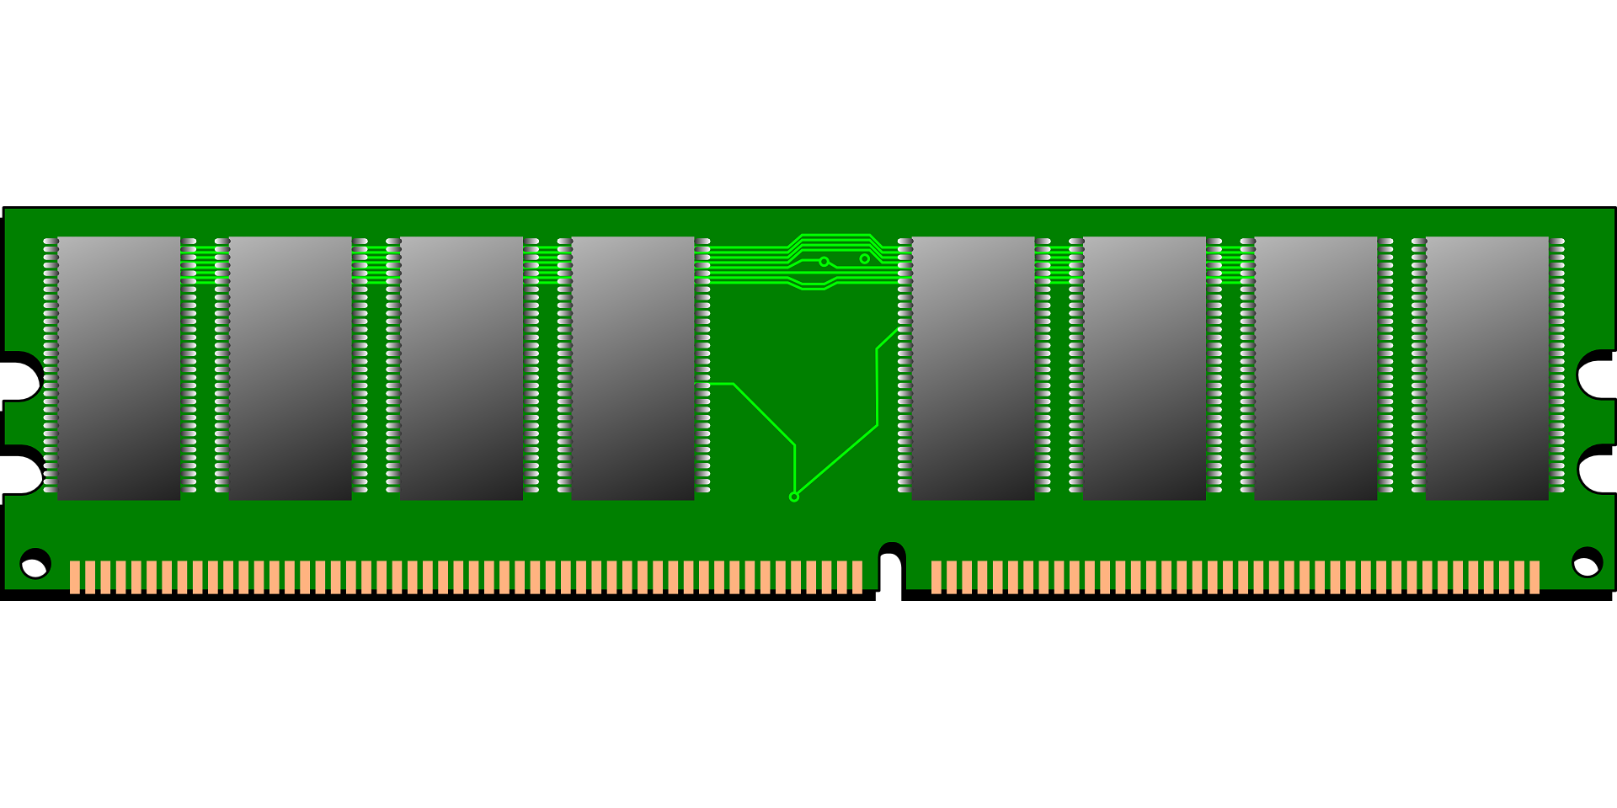
Computer bases
Computer bases
Data bus
Address bus
Control bus

Slide 8

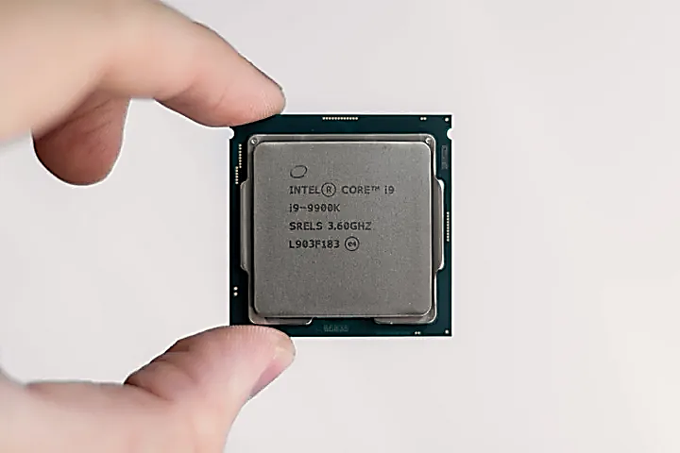
Frequency
Frequency is the number of cycles per second, measured in Hertz (Hz).
Example
This processor performs 3.6 billion operations per second

Slide 9
Units of data measurement
Bit = 0 & 1
Byte = 8 Bits
1 Kilobyte = 1,024 Bytes
1 Terabyte = 1,024 Gigabytes
1 Gigabyte = 1,024 Megabytes
1 Megabyte = 1,024 Kilobytes
1 Petabyte = 1,024 Terabytes
1 Exabyte = 1,024 Petabytes
1 Zettabyte = 1,024 Exabytes
1 Yottabyte = 1,024 Zettabytes

Slide 10
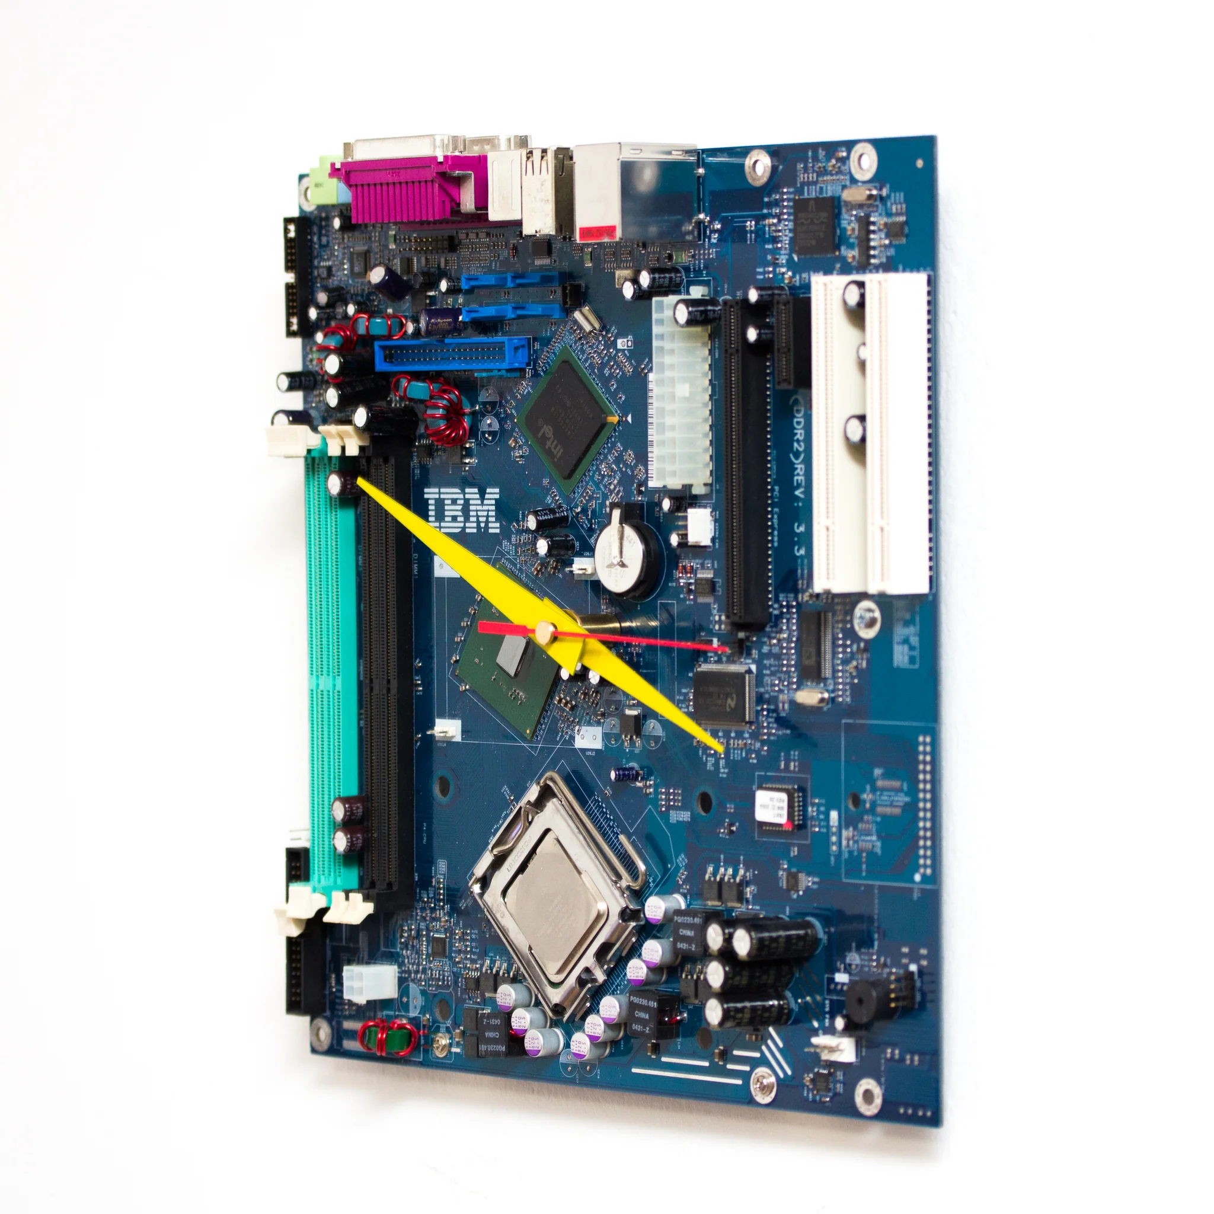
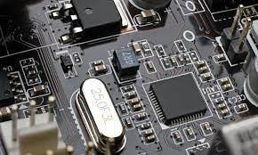

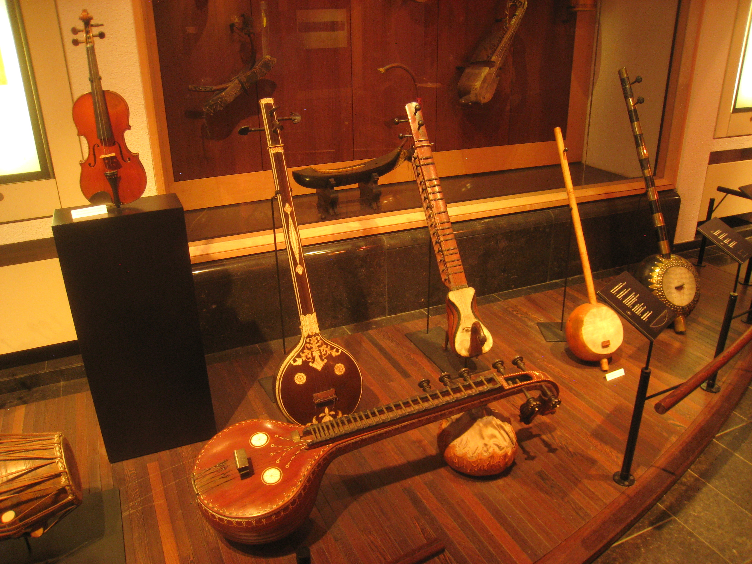
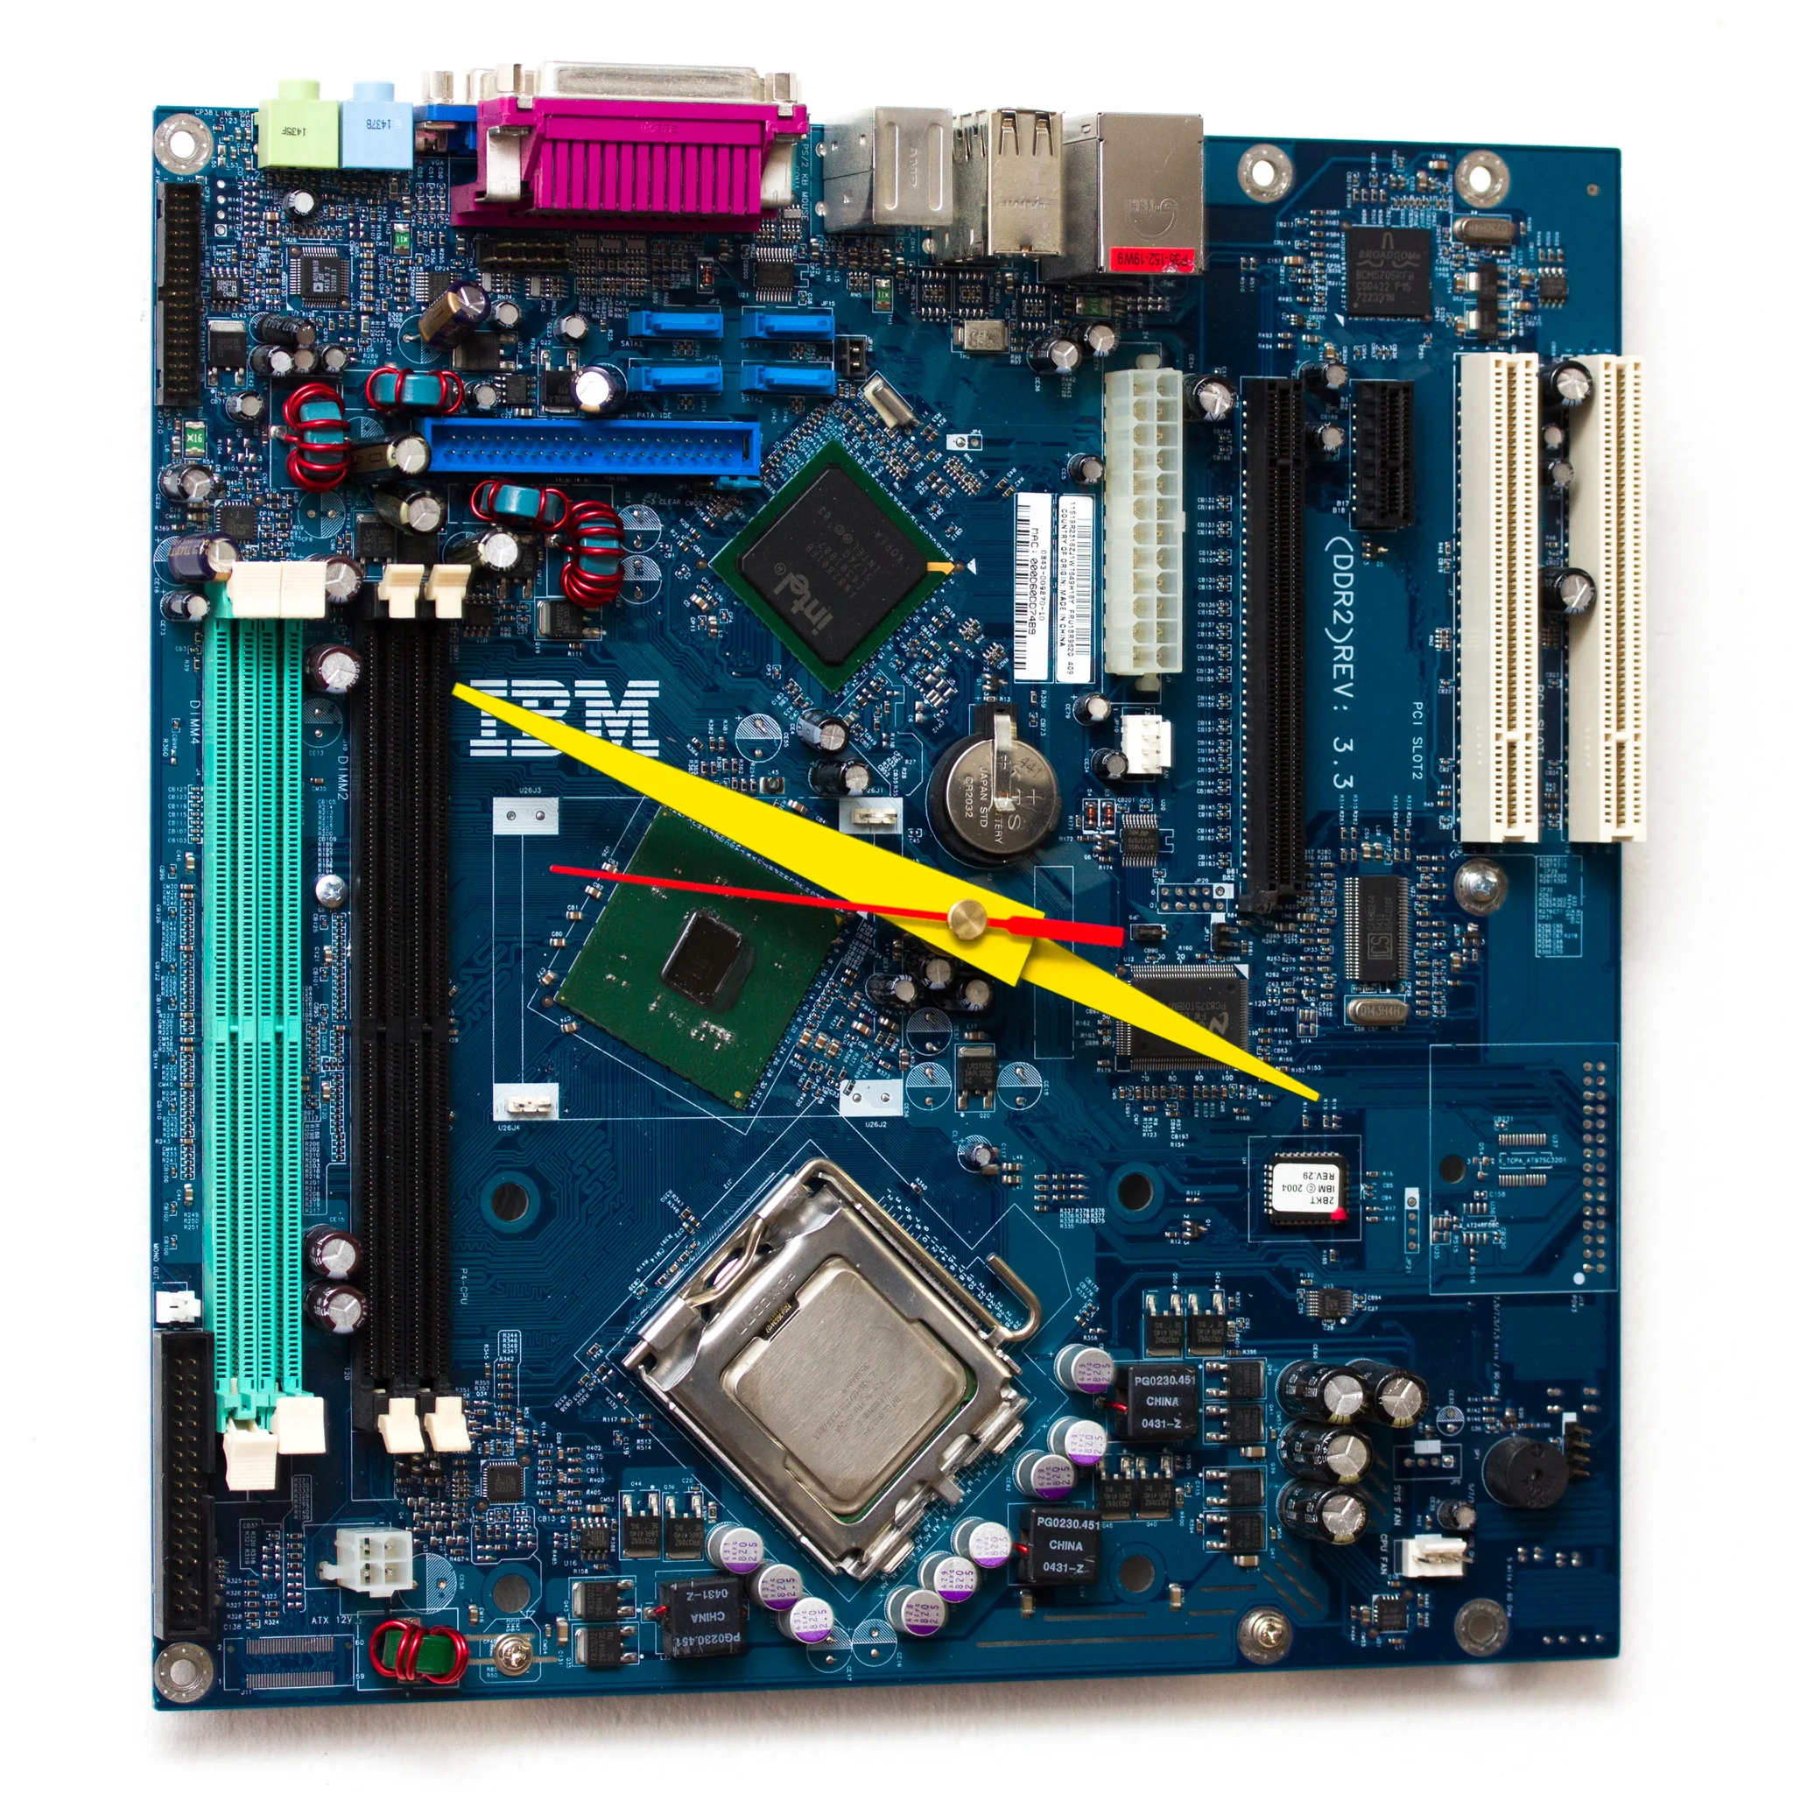
System clock (sequence)
ركز اوي في النقطة دي ي محسن
bandwidth

Slide 11

Tank you

